Slide 1
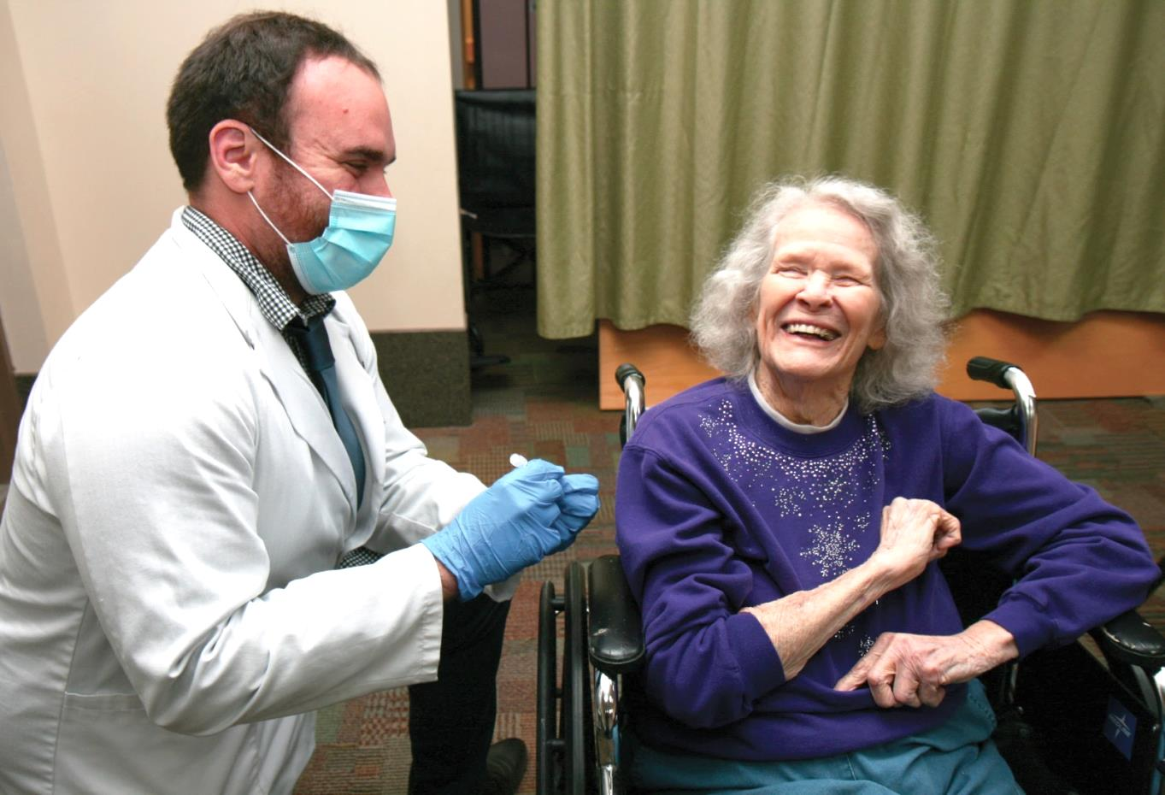
January 4 – 5, 2021: Round 1 of Covid-19 vaccinations given at Good Samaritan Center. Since then, they were made available for the entire community. We praise God for this positive step!

Slide 2
Ministry continued at ACV throughout 2020,
thanks to friends like you. We are profoundly
grateful for the support of many churches.
Now in 2021, we continue to offer hope to those in need.
Please remember them as you prayerfully
consider giving to Advent Christian Village.
We ask you to pray for ACV and,
as the Lord leads, please send your best gift today.
Advent Christian Village 5th Sunday
PO Box 4305 • Dowling Park, FL 32064
www.acvillage.net/giving • (386) 658-5110
Please consider naming ACV as a beneficiary of your will or accounts.

